Slide 1
Linguistic Phonics
Information Session for parents

Slide 2
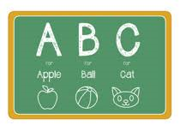
What is Linguistic Phonics?
A programme that teaches children the sounds we use in the English Language
Linguistic Phonics does not teach letter names

Slide 3
Phonological Skills
Segmenting – separating the sounds in words h a t
Blending – pushing together the sounds in words
Manipulating sounds in and out of words e.g. h a t h o t

Slide 4
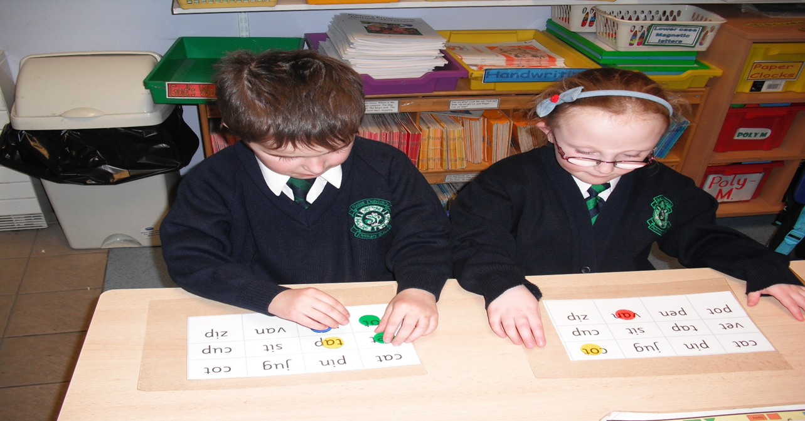
Stage 1
One – Letter, One – sound
CVC words
Sounds are represented by letters

Slide 5
Stage 2
More complex and longer words
CCVC words and CVCC words
Skills are the same – segmenting, blending, manipulating phonemes
It is vital that pupils learn to blend sounds automatically so that fluency develops

Slide 6
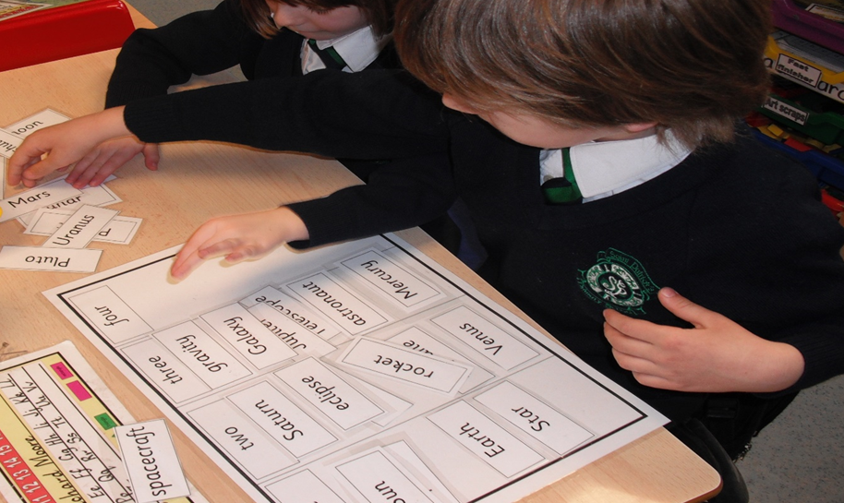
Stage 3
Multi-syllable words
To identify blocks of sound (syllables) in words
To segment blocks of sounds (syllables) in words
To blend blocks of sounds (syllables) together to make whole words

Slide 7
Stage 4
One sound can be represented by more than one letter
Words with ll, ff, zz, ck, th, ch, sh, ng, qu
Same skills
Segmenting, blending and manipulating

Slide 8
Stage 5
The same phoneme can be represented in more than one way e.g toe snow road nose
Same spelling may represent more than one sound e.g. teach bread
The skills at this stage are segmenting, blending and identifying and categorising various representations of the same sound

Slide 9
Helping your child to read
Look at the pictures
Talk about the title, characters and the story
Sound out any difficult words
Ask questions
Pause , prompt and praise

