Slide 1
St Patrick’s Primary School
Eco Squad
would like to talk to you about…
Earth Hour 2019

Slide 3
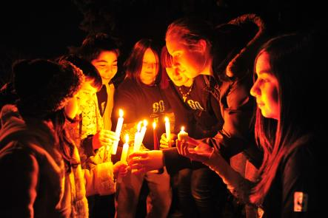
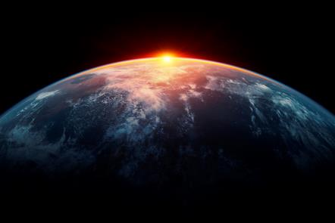
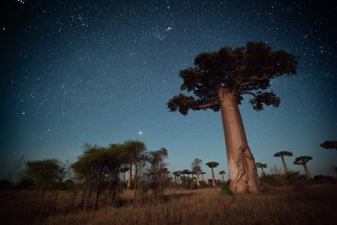
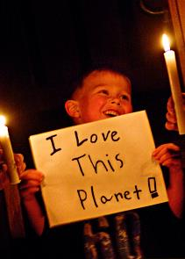
BE PART OF EARTH HOUR 2019
Fight for your world this Earth Hour. Join millions of people in a global campaign to switch off their lights.
The world’s largest display of support for action to protect the planet.
Take part with family and friends on 8.30pm, Saturday 30 March
Take part in your school in the week leading up to Earth Hour
© WWF-Canada / Frank PARHIZGAR
© Bjorn Holland / Getty Images / WWF
© Shutterstock / Dudarev Mikhail / WWF
© Jeremiah Armstrong / WWF-Canada

Slide 4
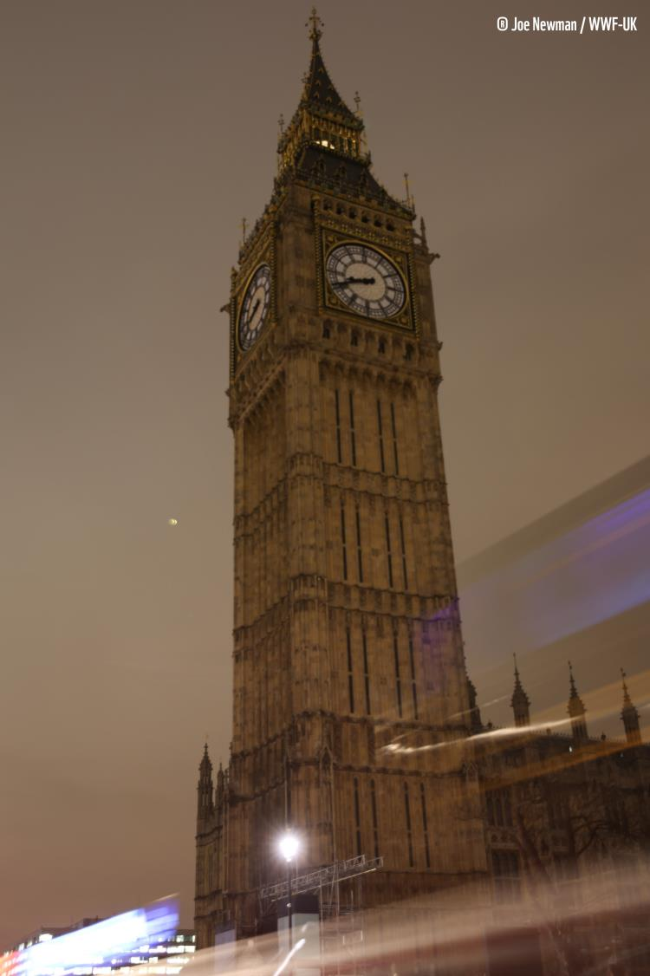
2018
HIGHLIGHTS
188 countries and territories took part
Close to 18,000 landmarks and monuments from the Sydney Opera House to the Eiffel Tower and from Buckingham Palace to Edinburgh Castle switched off their lights as millions united to fight for our planet.
In the UK 10 million people took part in Earth Hour 2018.
Over 7,000 schools took part.

Slide 5
Nature is our life support system. It gives us
Clean air to breathe
Water to drink
Food to eat
Energy to keep us warm
Materials to make things
The wonders of nature to enjoy
but…
© Richard Stonehouse /WWF-UK

Slide 6
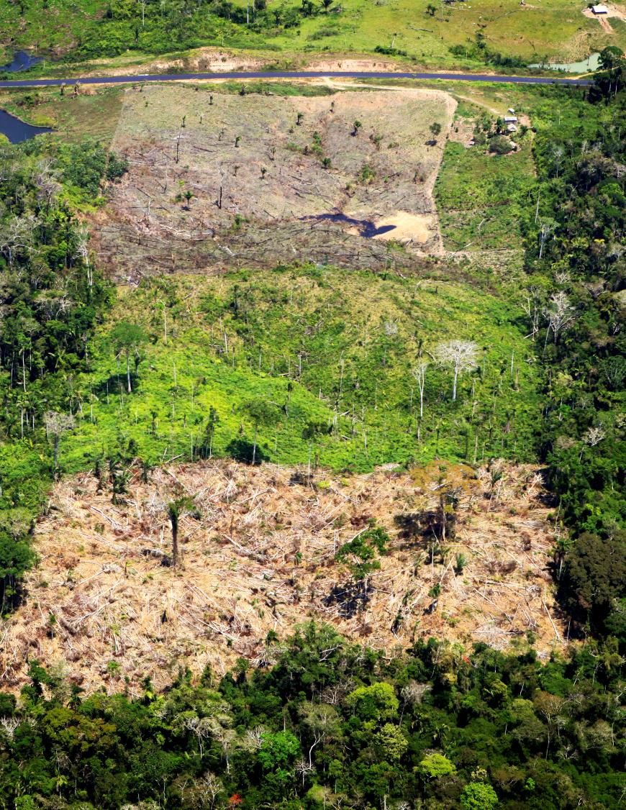
We’re threatening the
future of our planet
The wildlife we love is vanishing
Vital ecosystems such as forests are being chopped down
Our seas are choking in plastic
Extreme weather events are increasing due to climate change
© Greg Armfield / WWF-UK
Notes:
Nearly 1 in 6 species are at risk of extinction.
We lose an area of forest the size of a football pitch every two seconds.
There could be more plastic in the seas than fish by 2050.
This century has already seen 17 of the 18 hottest years on record. More frequent floods, wildfires, and drought are threatening peoples homes and livelihoods.

Slide 7
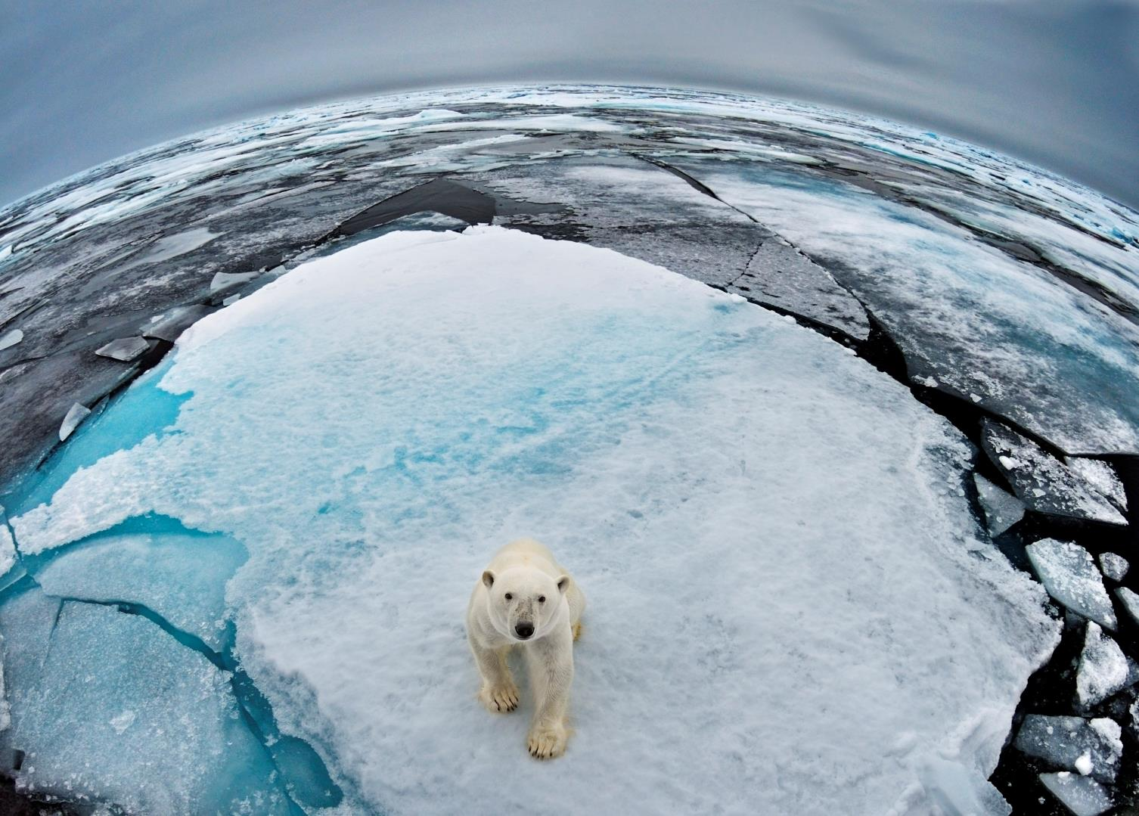
© naturepl.com / Andy Rouse / WWF
We are the first generation to know that we are destroying our world. And we could be the last to do anything about it.

Slide 8
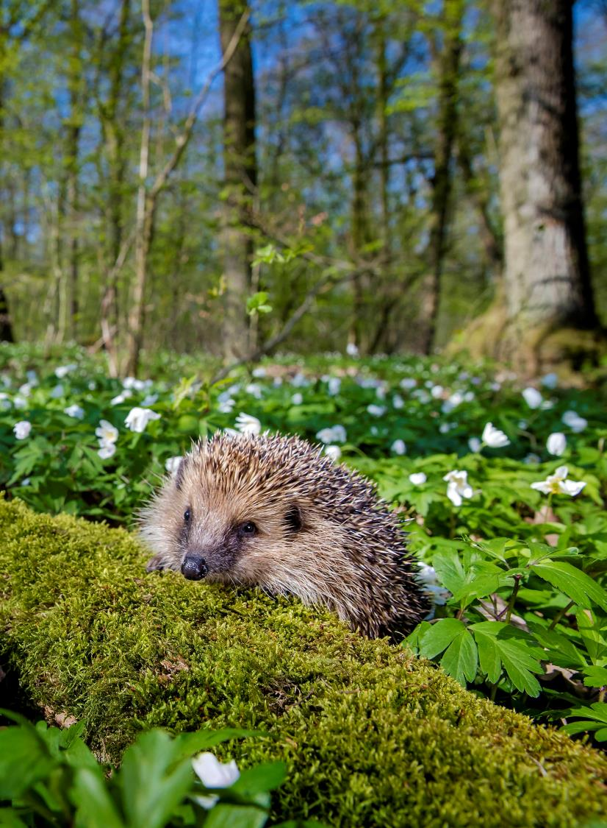
When nature thrives,
so do we
It’s time to fight for our world:
Protect our wildlife
Fix our food system
Fight plastics pollution
Tackle climate change
© naturepl.com / Klein & Hubert / WWF

Slide 9
IT’S UP TO US TO PROTECT
OUR PLANET!
It might seem as if all our decisions are small and don’t matter. But they do!
If one person chooses to use less plastic, that’s great! If 100,000 people choose to, that’s a movement for change
The choices we make can help stop climate change and end biodiversity loss
© Jeremiah Armstrong / WWF-Canada

Slide 10
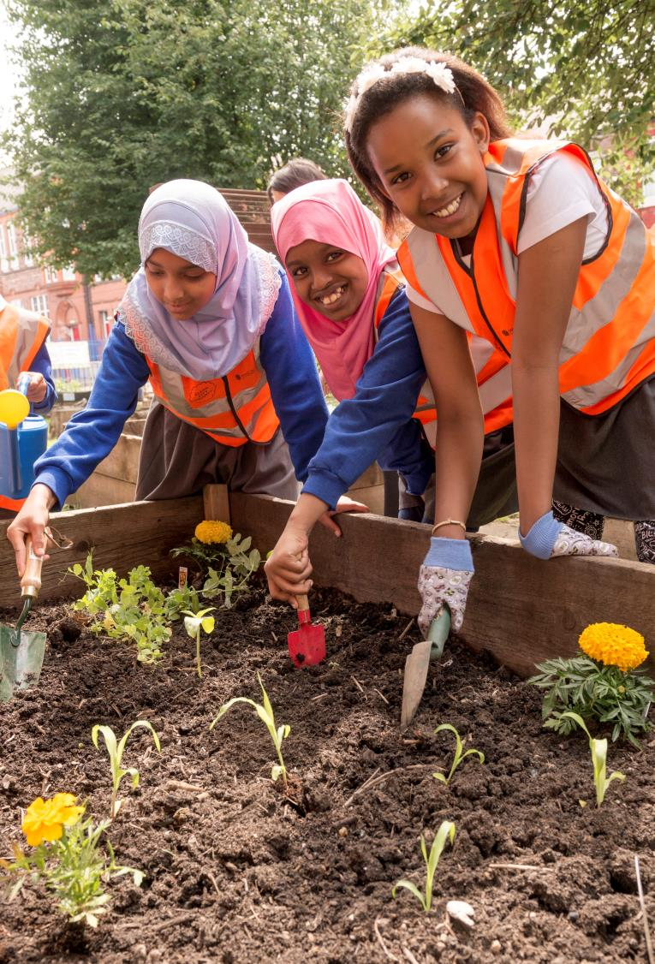
Think about:
walking or cycling instead of using the car
ditching the plastic water bottles
making sure your garden is wildlife friendly
eating a healthier, more balanced diet with more plant-based meals
organising a litter pick in your local community
© Richard Stonehouse /WWF-UK

Slide 11
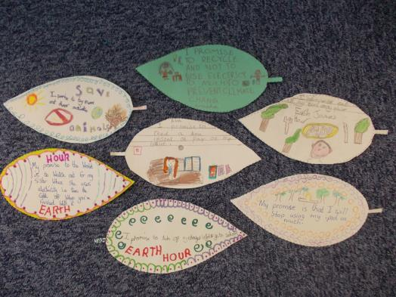
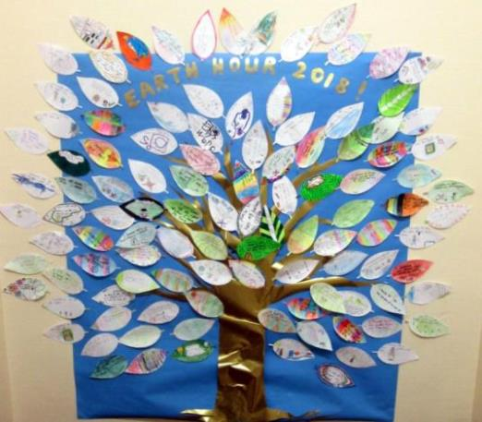
EARTH HOUR 2019
St Patrick’s was one of over 7,000 schools who took part in Earth Hour last year!
This year we would like everyone to take part by:
turning off lights, electrical appliances, whiteboards and computer screens for an hour (2 – 3pm) in school on Friday 29 March 2019;
making a promise for the planet;
Joining in ‘lights off’ at home with our families on Saturday 30 March 2019 from 8:30 – 9:30 pm
© Rydal Penrhos Prep / WWF-UK
© Wormit Primary School / WWF-UK

Slide 12
Say ‘NO’ to Plastic

Slide 13
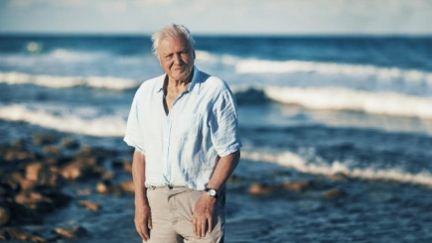
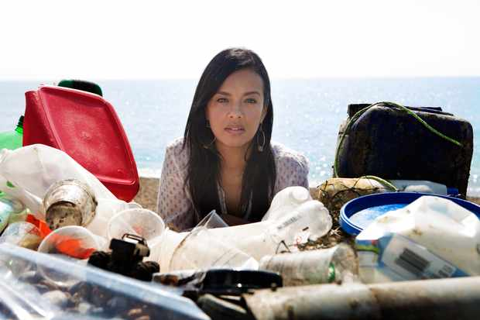
Here are two people who make documentaries about how plastic affects the world. The one on the left is David Attenborough from “The Blue Planet” and the one on the Right is Liz Bonnin who made a documentary called “Drowning In Plastic.”

Slide 14
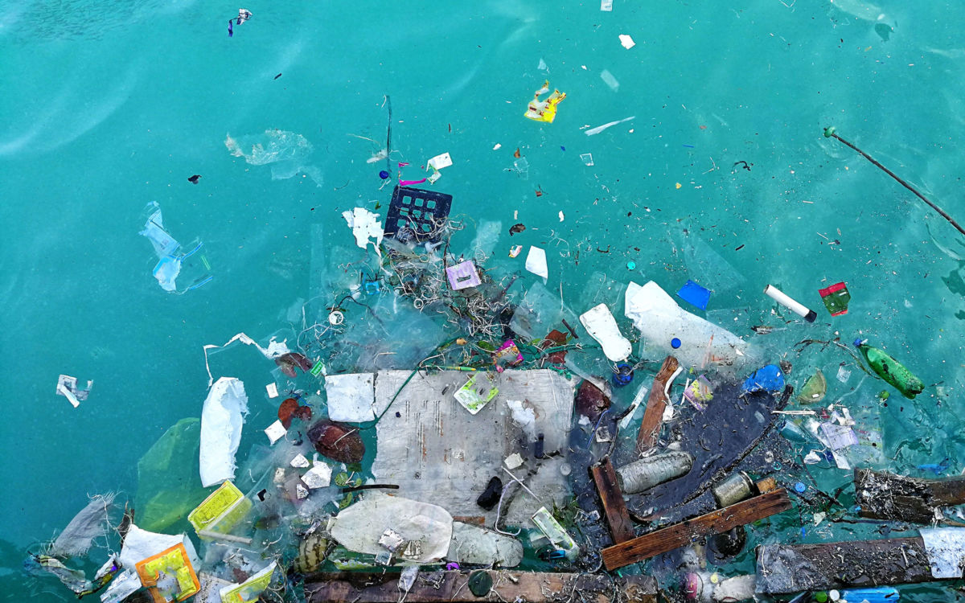
SAY NO TO PLASTIC POLLUTION
Plastic is everywhere. From our local rivers and beaches to the remote Arctic sea, it is choking our oceans and killing wildlife.
Every year we dump 8 million tonnes of plastic waste into our seas - the equivalent weight of over 600,000 double decker buses.

Slide 15
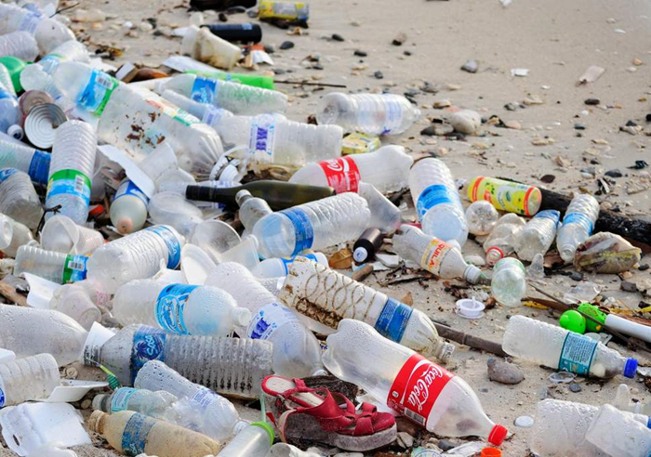
Plastic pollution is also a major threat to marine life. According to scientists, plastic particles can be found in 90% of the world’s seabirds.

Slide 16
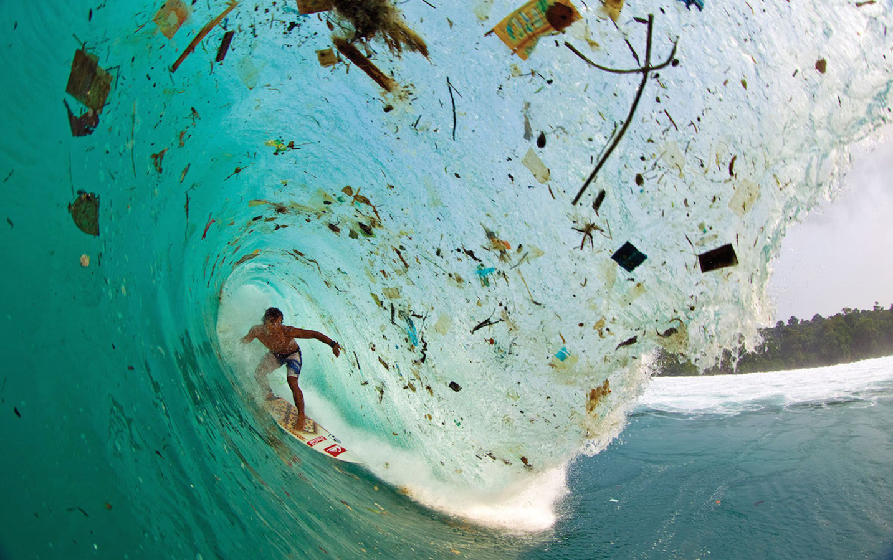
If we don’t act now, by 2050 there will be more plastic in the sea than fish.
We can all try to use less plastic and to reuse and recycle. But we also need to persuade producers to curb plastic pollution.

Slide 17
We are going to show you a video called
‘Fight for your World’.
https://www.youtube.com/watch?v=3oT4AEJL3yI&feature=youtu.be
As you watch, think about what the film tells us about 4 areas:
Wildlife
The food we eat
Plastic pollution
Climate change
What do you think the main message of the film is?

Slide 18
As the video says,
we can win the biggest battles in the smallest moments.
Some of the ways in which we can fight for our world:-
include:
walking or cycling to school
using less water
saying no to plastic drinking straws
planting wildlife friendly areas in school
eating foods that are in season or locally grown (or even growing your own food)
saving on electricity by not leaving the TV or computer on standby
recycling more
learning more about nature and the natural world.

Slide 19
How to save the world from plastic pollution
1. Reduce
2. Reuse
3. Recycle
4. Refill

Slide 20
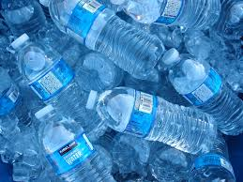
Reduce
Reduce plastic by not buying plastic bottles. Use reusable bottles. If you keep buying plastic bottles they will keep on making them.

Slide 21
Recycle
Recycle the plastic bottles that you have already used. Do not throw them in the sea or leave them on beaches or send to landfill.

Slide 22
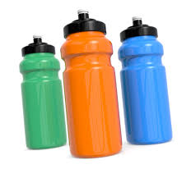
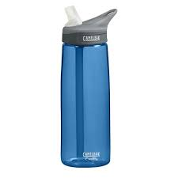
Reuse
Use refillable bottles - don't just go to the shop and buy plastic bottles for a school day

Slide 23
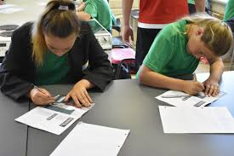
Refill
Refill your reusable bottles.
You should drink up to 6-8 glasses of water per day, here are two pictures to show how water helps.
Dehydrated
Hydrated

Slide 24
We think better and learn better when we are HYDRATED!!!

Slide 25
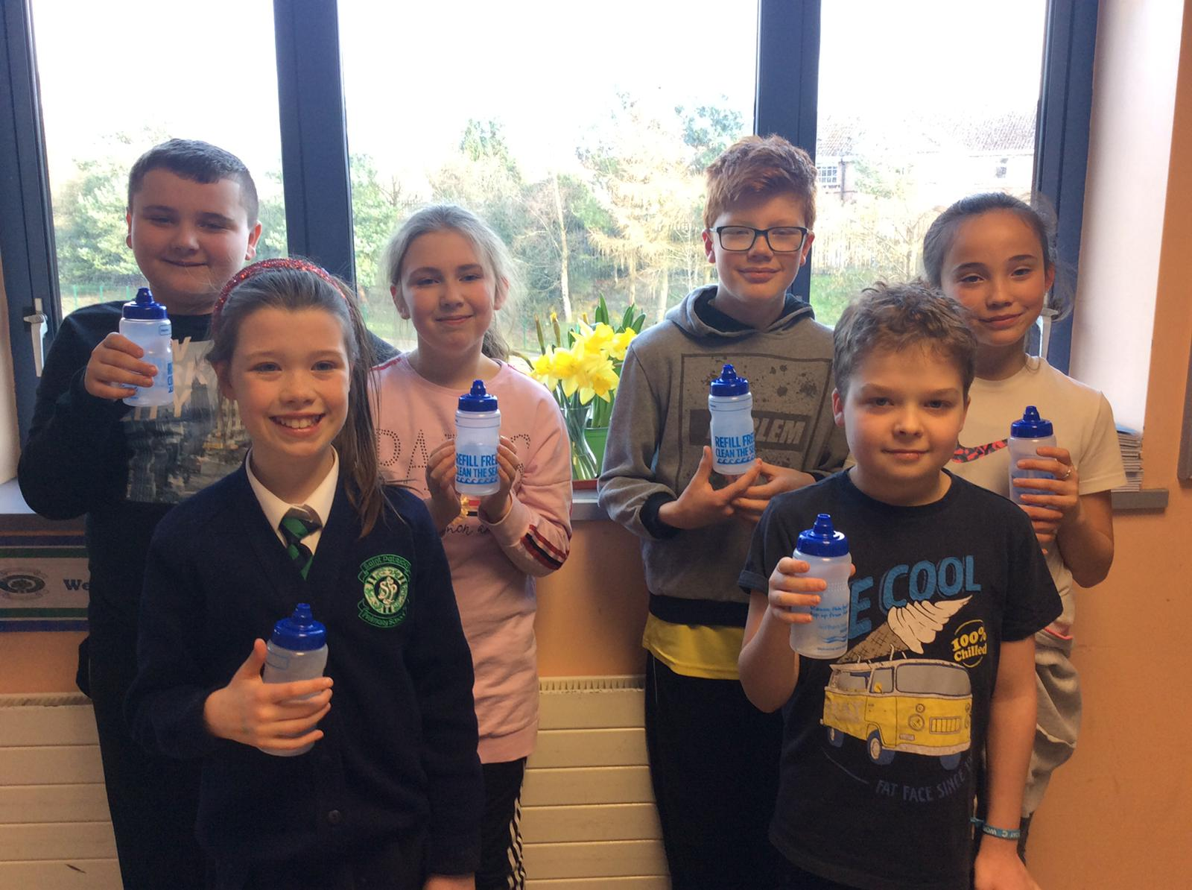
Here at St Patrick’s eco club we are giving out free, reusable bottles, provided by N.I Water. There is a free bottle for every pupil and teacher!
We hope that you will take care of your bottle and use it every day!

Slide 26
Will you all make a promise for the planet?
On a leaf template, write down one thing that you will do to ‘fight for our world’,
eg, walk to school or use the reusable water bottle from NI Water, rather than plastic disposable ones.
We can display these leaves in school to show what we are trying to do to protect our Earth.
By Ronan Hagan.

Slide 27
Hannah made a video to encourage everyone to drink tap water from the NI Water reusable bottle which you will all be receiving soon!

