Slide 1
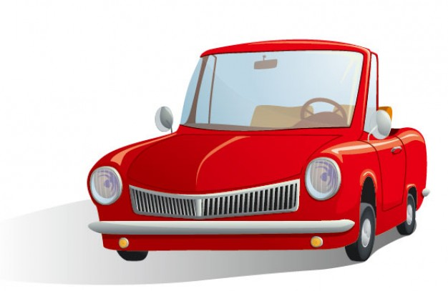
Carr
Car

Slide 2
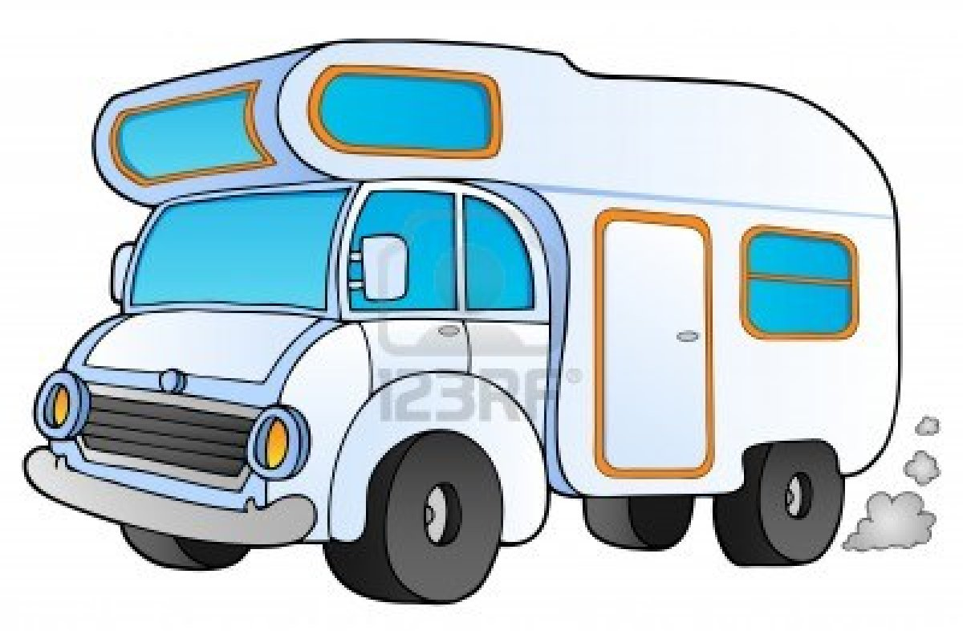
Carbhán
Caravan

Slide 3
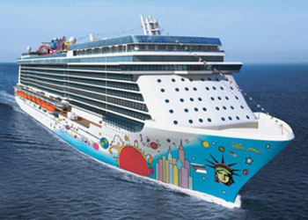
Bád
Boat

Slide 4
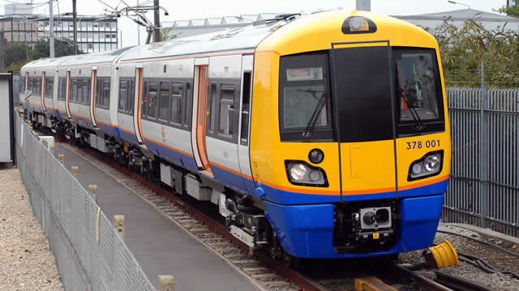
Traein
Train

Slide 5
Eitleán
Plane

Slide 6
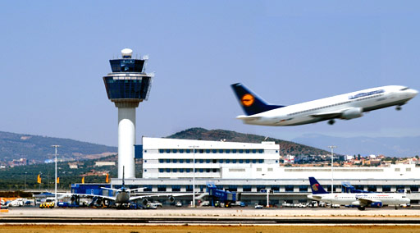
Aerfort
Airport

Slide 7
Ag obair is ag foghlaim
le chéile ón bhaile.

Slide 8
Working and learning
from home.

