Slide 1
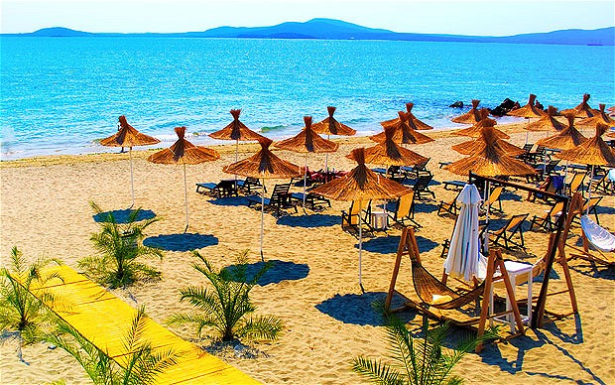

Laethanta saoire
Holidays

Slide 2
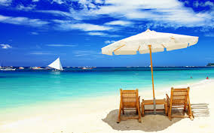
An trá
Beach

Slide 3
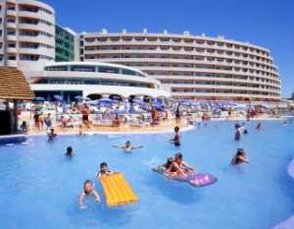
Linn snámha
Swimming pool

Slide 4
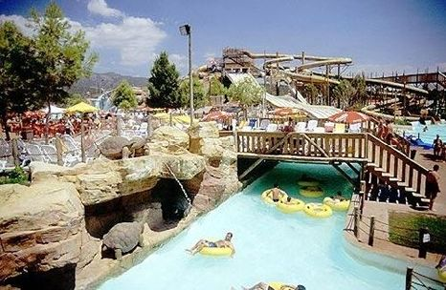
Páirc uisce
Water park

Slide 5
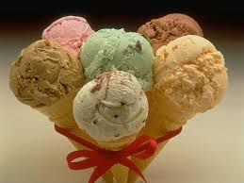
Uachtar reoite
Ice cream

Slide 6
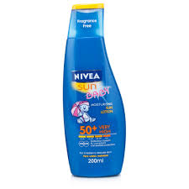
Uachtar gréine
Sun cream

Slide 7
Óstán
Hotel

Slide 8
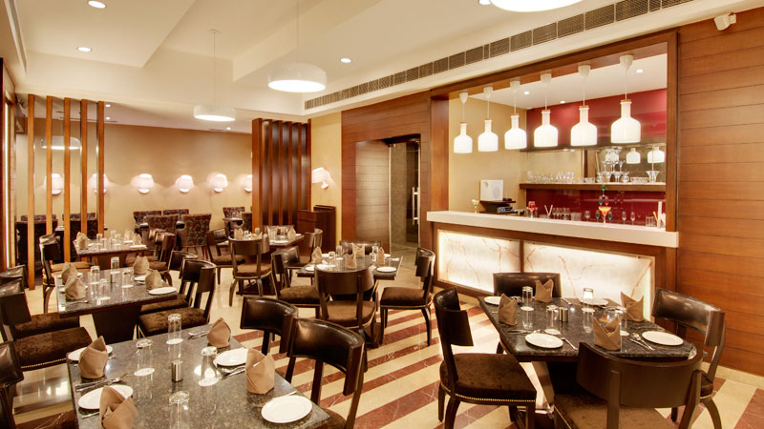
Bialann
Restaurant

Slide 9

Ag obair is ag foghlaim
le chéile ón bhaile.

Slide 10
Working and learning
from home.

